Slide 1

Short-form Video Shooting Guidelines
2026. 04. 09.

Slide 2
Please make sure to familiarize yourself with this before filming
Video length
Minimum 3–5 minutes per section / Total shooting time - minimum 20 minutes(ex) 5mins of exterior view, 5mins of store interior, 5mins of product shooting, 5mins of on-site reaction
Shooting method
Use of first-person perspective for viewer’s immersion, and fix the camera as much as possible when filming indoors to prevent camera shake.
Subtitle
Submitting filming information as text is required to write down the subtitle during the editing process.
Tasting
If you have purchased the product, prepare and submit at least one sentence of your impressions after tasting. (No need to shoot the face)
Sound
Will insert background music during the editing process
(Filming noise is acceptable, to enrich the video voice modulation will be applied if narration is provided, subtitle will be inserted if it’s difficult to record the narration)
Portrait rights
Faces of passersby will be blurred during the editing process, but please be careful not to capture them on screen as much as possible.
Take the photo of package and labeling carefully. mandatory to open the product and take the photo of the contents
For drinks: If the package is opaque, need to film the process up to the point of opening and pouring it into a cup
Purchased products
Brand exposure
Korean products could be partially blurred during the editing process to avoid exposure of specific brands.

Slide 3
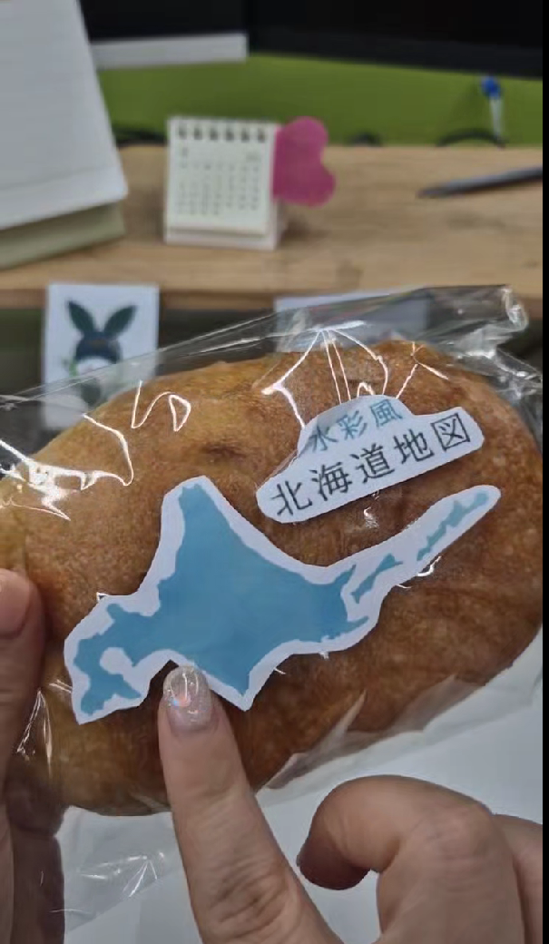
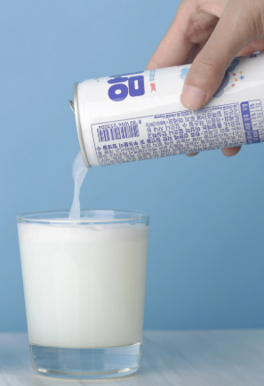
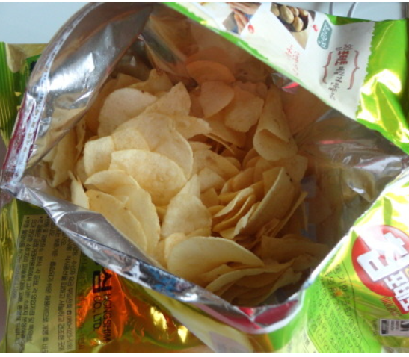
Purchased products
Drinks: If the package is opaque, need to film the process up to the point of opening and pouring it into a cup
Shoot the packaging and labeling clearly
Need to open the products to shoot the contents inside

Slide 4
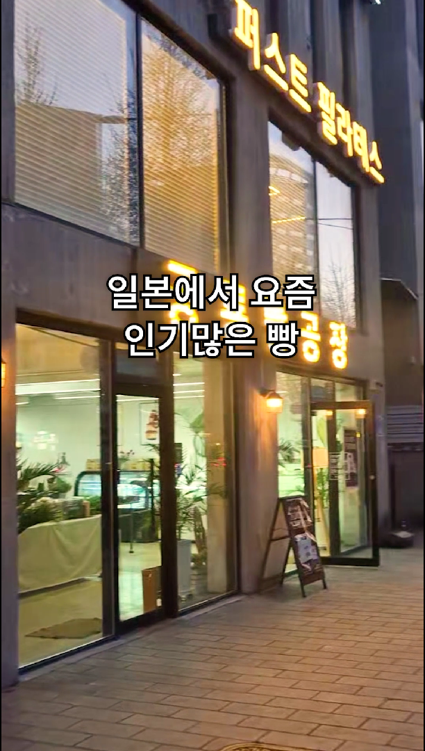
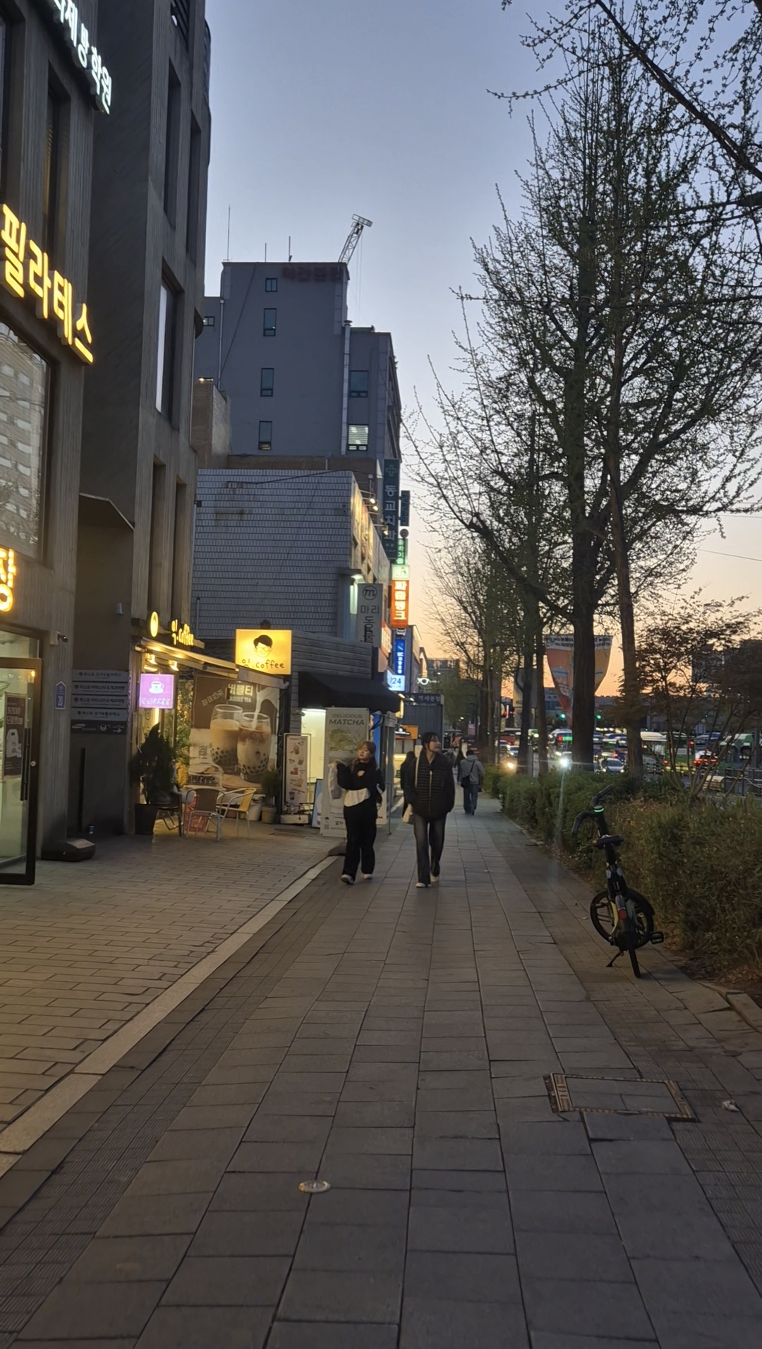
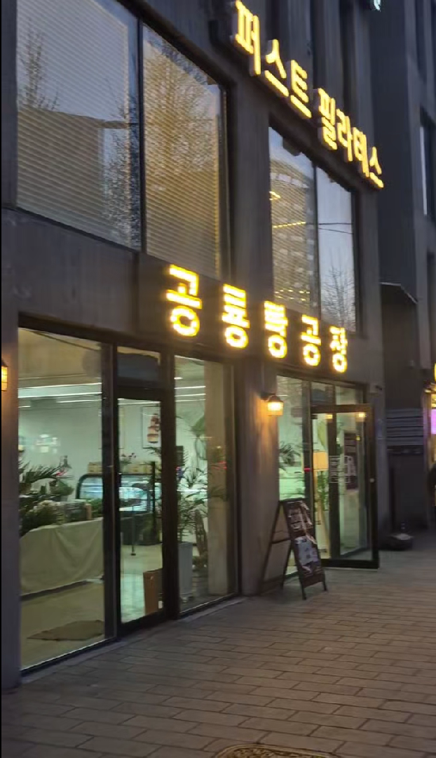
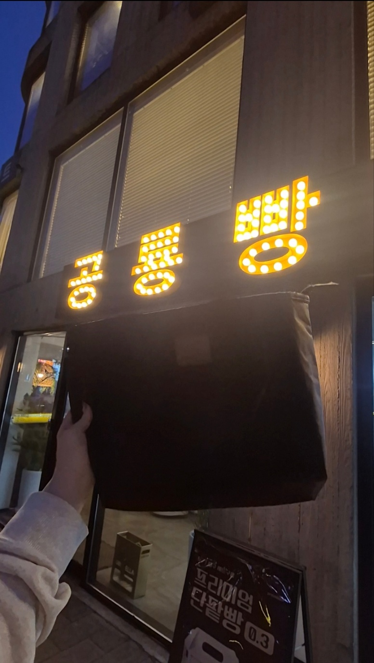
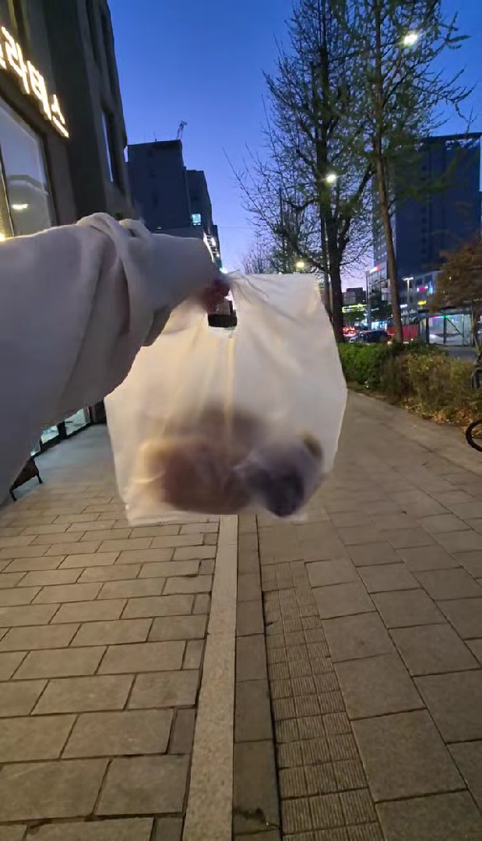
ㅇRequest active sharing of vertical photos and short video shots from various angles
ㅇRequest the sharing of logos, files of promotional material design, etc. for each project/event
ㅇRequest sharing of key details for each recording (names of participating organizations/facilities/schools, program/event names, locations, etc.)
Video shooting guide for reels
While shooting video,
Please film for at least 10 seconds per scene.
Please submit the footage following the flow below.
Please shoot vertically in 9:16 aspect ratio, considering the characteristics of reels.
(Street view) Please shoot ‘slowly’ in ‘moving angle’
Even for the same scene, it is better to walk slowly and capture the entire view, such as from left to right or right to left.
(Exterior view)
Ex) Trending Japanese bakery items
Street view
(Better to include the routes to make the street or outdoor scenery of the event venue can be shown clearly)
Store close-up shot
(Shoot the store or event booth to be shown clearly)
Signboard close-up shot
(Shoot the signboard clearly)
Product+Exterior view
(Shoot the product and the exterior view in a single shot)

Slide 5
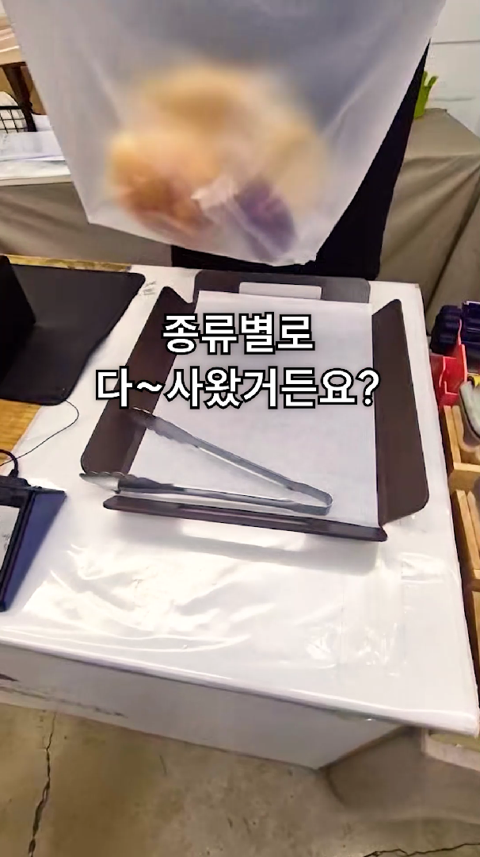
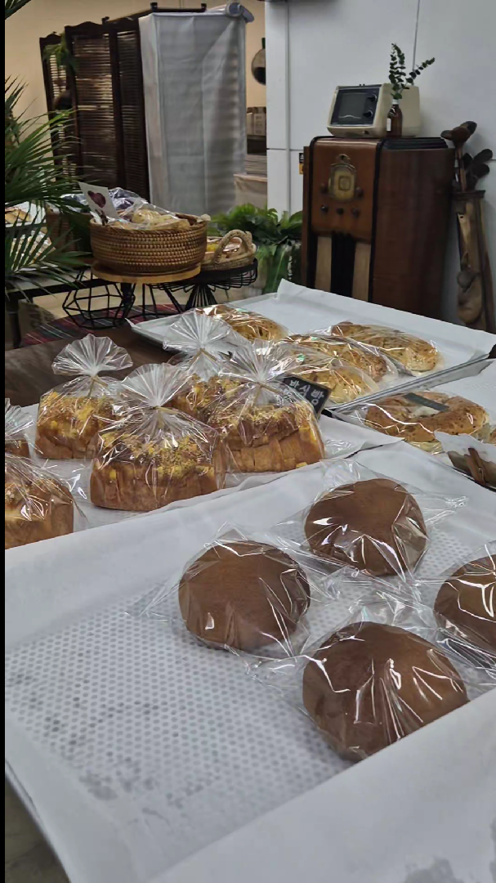
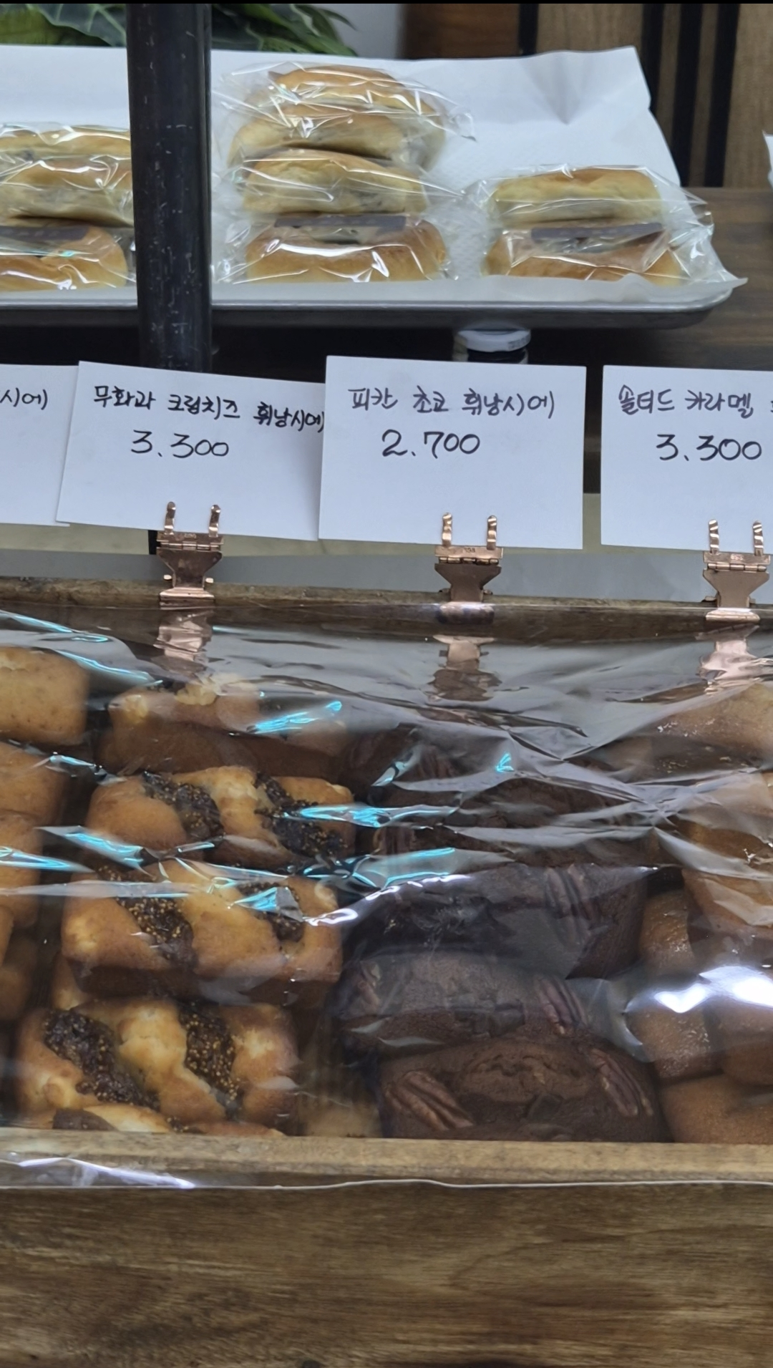
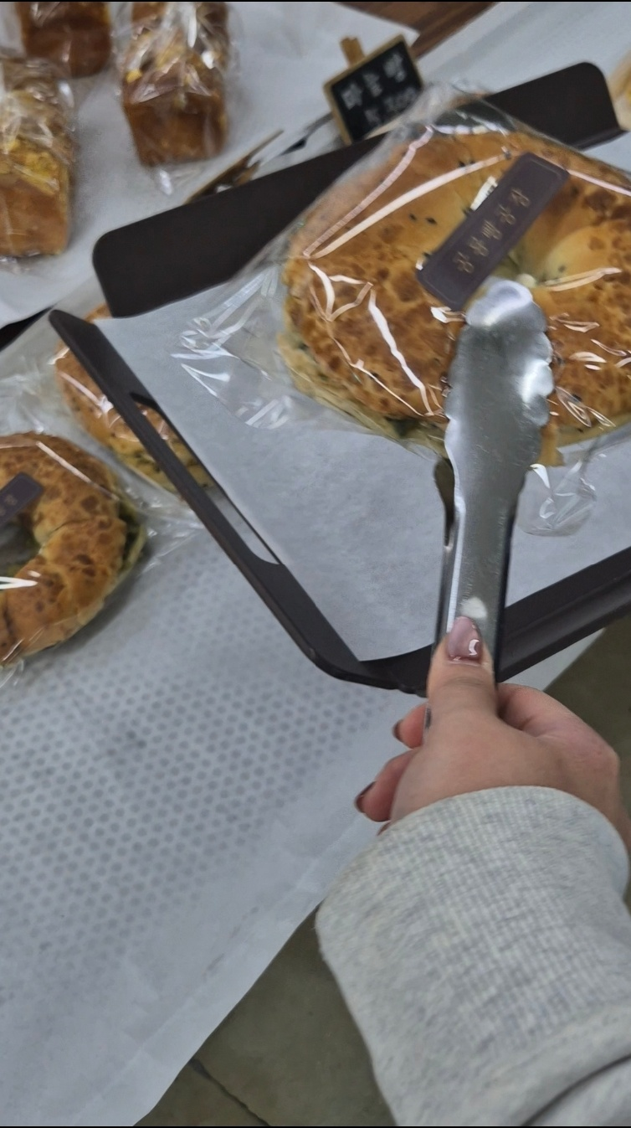
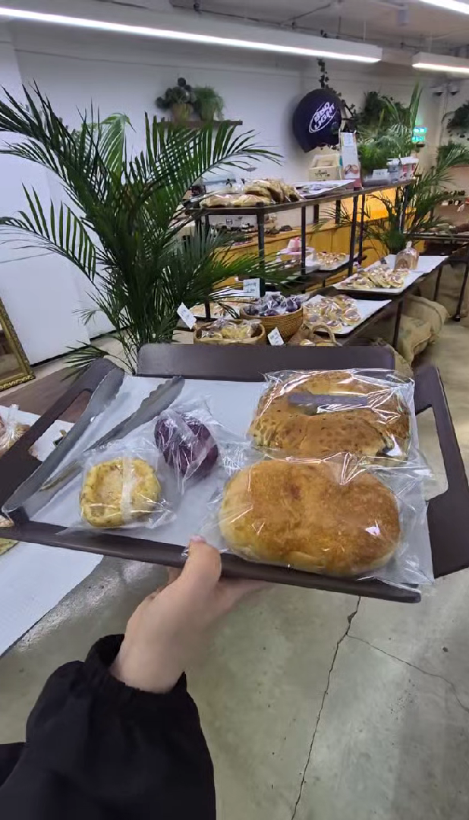
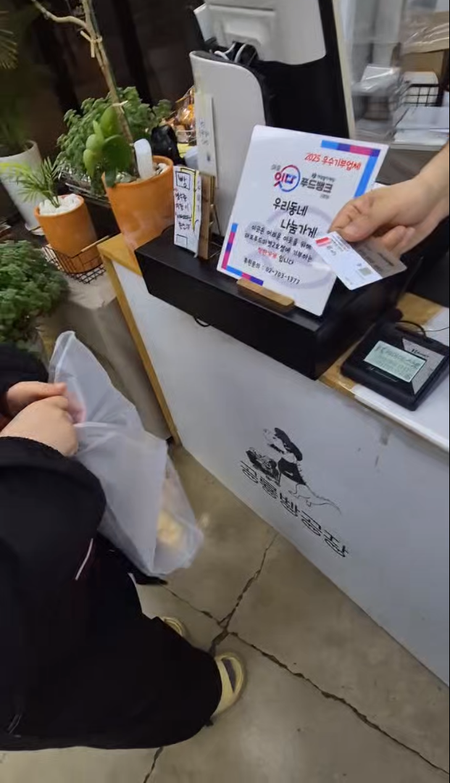
ㅇRequest active sharing of vertical photos and short video shots from various angles
ㅇRequest the sharing of logos, files of promotional material design, etc. for each project/event
ㅇRequest sharing of key details for each recording (names of participating organizations/facilities/schools, program/event names, locations, etc.)
While shooting video,
Please film for at least 10 seconds per scene.
Please submit the footage following the flow below.
Please shoot vertically in 9:16 aspect ratio, considering the characteristics of reels.
(Interior view) Please shoot ‘slowly’ in ‘moving angle’
Even for the same scene, it is better to walk slowly and capture the entire view, such as from left to right or right to left.
(Interior view of stores/event venue)
Ex) I bought one of every kind!
Interior view
(Better to include the routes to make the street or outdoor scenery of the event venue can be shown clearly.)
Display/product close-up shot
(Shoot the product’s name and price clearly)
One-person perspective
(To maximize the sense of direct experience)
Product+Interior view
(Shoot the product and the exterior view in a single shot)
Experience
(Film the various scenes including purchase and booth participation)

Slide 6
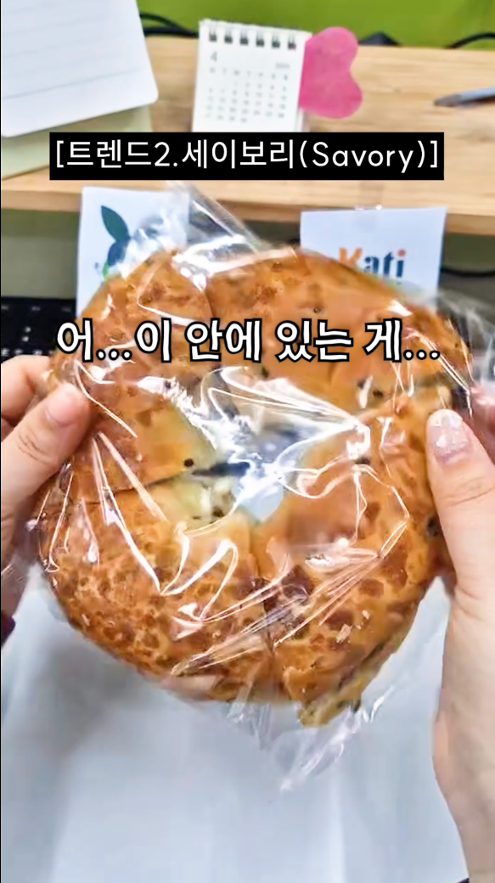
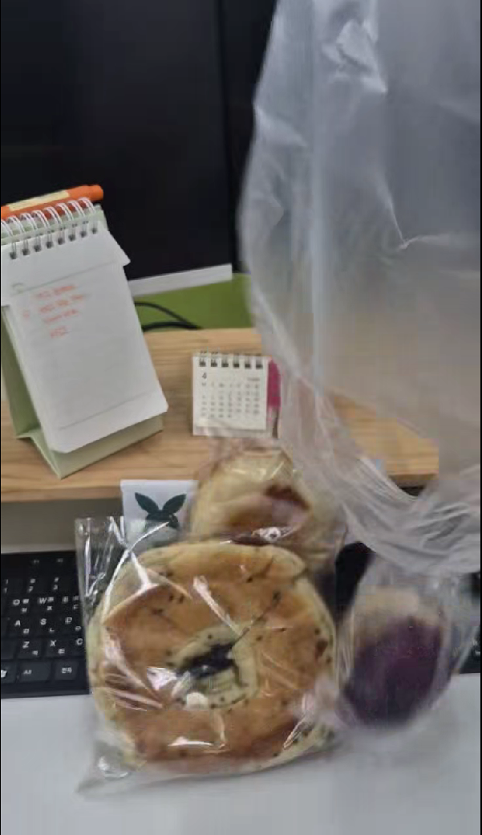
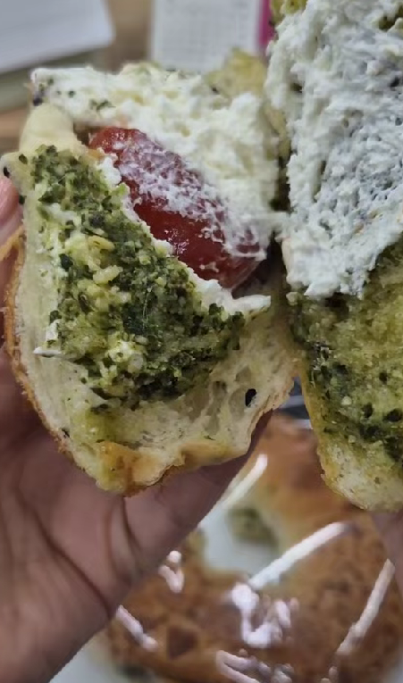
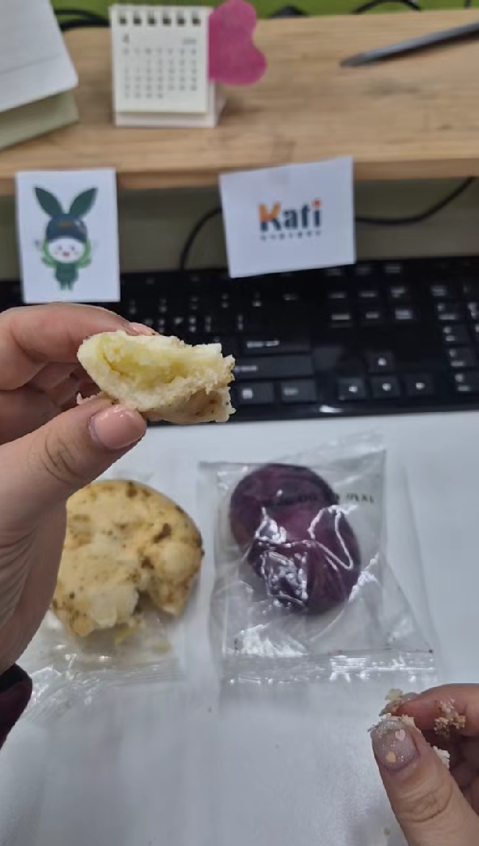
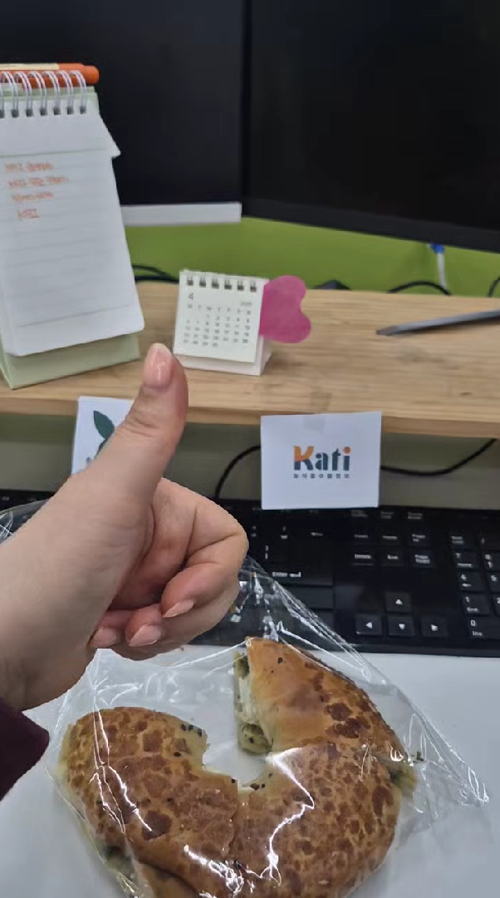
ㅇRequest active sharing of vertical photos and short video shots from various angles
ㅇRequest the sharing of logos, files of promotional material design, etc. for each project/event
ㅇRequest sharing of key details for each recording (names of participating organizations/facilities/schools, program/event names, locations, etc.)
While shooting video,
Please film for at least 10 seconds per scene.
Please submit the footage following the flow below.
Please shoot vertically in 9:16 aspect ratio, considering the characteristics of reels.
(Product shoot) Please fix the camera in place before shooting to prevent camera shake
Best to film from one-person perspective for immersive experience
(Product shoot)
Ex) Trend 2: Savory
Ex) Oh... what’s inside here is...
Full shot
(Show the entire purchased product)
Individual product shot
(Shoot the product’s packaging and design clearly)
Point close-up shot
(Shoot key points such as ingredients, logos, and textures in detail via close-up shot)
Tasting/experience
(Maximize the feeling of actually eating the product by utilizing a technique where the product disappears out of the frame.)
Reaction
(Use sounds and hand movements to describe the product's taste and texture, etc)

Slide 7
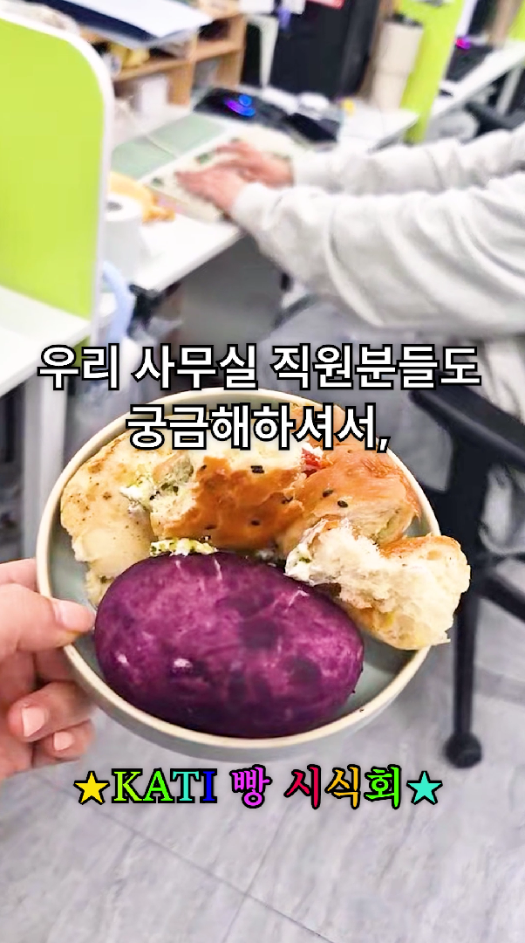
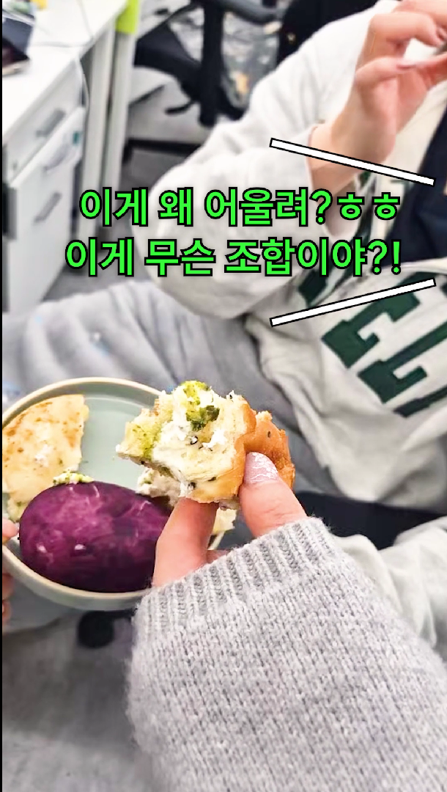
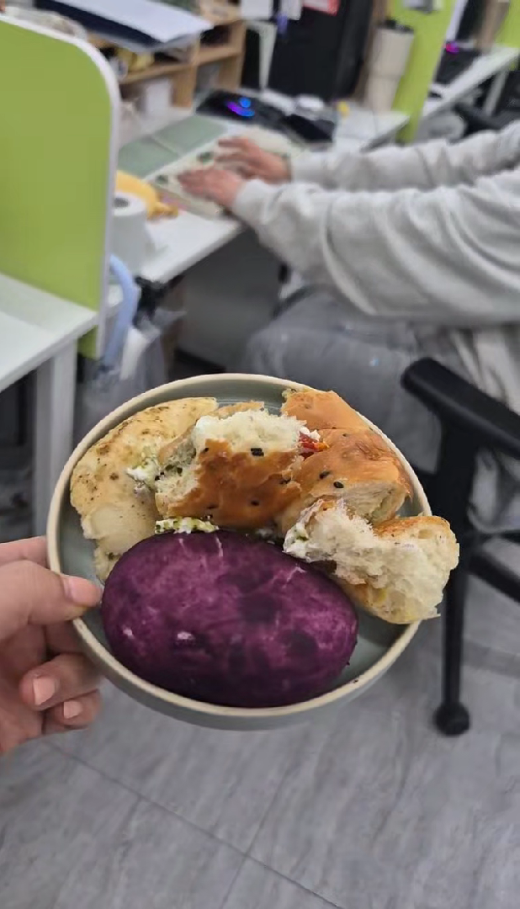
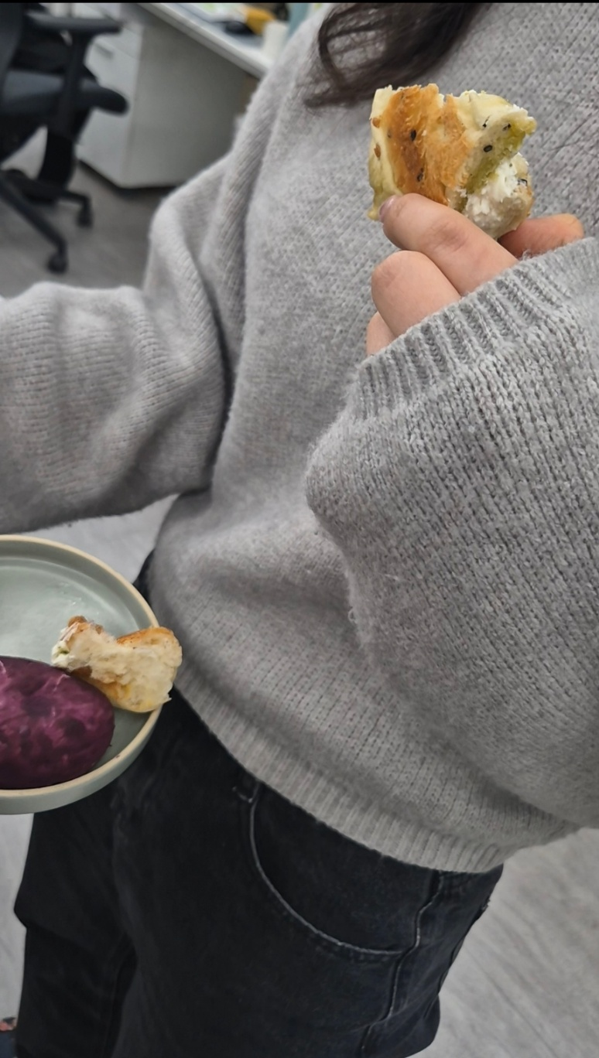
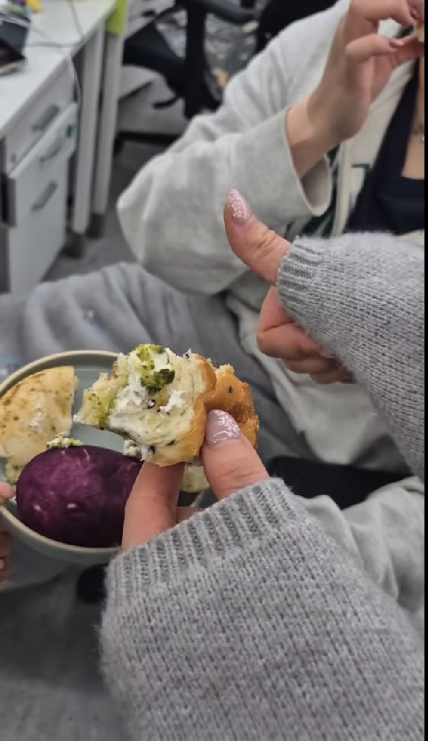
ㅇRequest active sharing of vertical photos and short video shots from various angles
ㅇRequest the sharing of logos, files of promotional material design, etc. for each project/event
ㅇRequest sharing of key details for each recording (names of participating organizations/facilities/schools, program/event names, locations, etc.)
While shooting video,
Please film for at least 10 seconds per scene.
Please submit the footage following the flow below.
Please shoot vertically in 9:16 aspect ratio, considering the characteristics of reels.
(On-site reaction) Please direct the shoot with a natural vibe.
Best to shoot handheld as if moving through the scene, rather than using a fixed angle, to give it a natural vibe
(On-site reaction)
Ex) Why does this actually work? What kind of combination is this?!
Ex) Since my colleagues wanted to know as well,
Product+On-site scene
(Showing the product and on-site view)
Portrait shooting
(Focus on the action and experience with close-up shots; unnecessary to show the face.)
Reaction
(Use sounds and hand movements to describe the product's taste and texture, etc)
Ex) Bread tasting party

